Slide 1
A Metric to Measure Contribution of Nodes in Neural Network
Jay Hoon Jung, Yousun Shin, Youngmin Kwon
2019 IEEE Symposium Series on Computational Intelligence (SSCI)
Dec 6-9 2019 , Xiamen, China

Slide 2
Introduction
The hidden layer DNN is a black box
Don’t understand how a NN works
Success, but can’t describe why and how
Don’t know how to optimize NN model
Cannot identify the unnecessary parameters
Less know how to eliminate the properly.

Slide 3
Previous approach
Simonyen (2013) derived internal structures to calculate gradient
Bach (2015) Presented layerwise Relevance (PLR) to calculate relative importance through layers
Shrikumar (2017) show Deeplift to make scores in each nodes
Chen (2018) show L2X (Learning to eXplain) to maximize mutual information between response variables and selected features

Slide 4
New Methods
Inspect hidden layers directly to reveal informative subset of features
Make a new metric to estimate influences between any two nodes
Create score, called an, influential score
Show the proportional contribution of a node with the respect to other nodes.

Slide 5
Abstract
Measure the influence of node in a layer NN to subsequent layer
Explain effect of elements in the input layer on the output layer
A way to inspect hidden layers of a NN
Inspect part of an image contribute positively and negatively
Explain about the input image on the classification result
Could explain how hidden layer control the output layer

Slide 6
Can be used to
Analyzing how hidden layers work in neural networks
Providing interpretable explanations about a prediction
Selecting subsets of features from an instance

Slide 7
Proposed Method
The scores are based on the trained weight of a NN and each node value for a specific input
The influential scores show how informative the elements of an input are compared to others

Slide 8
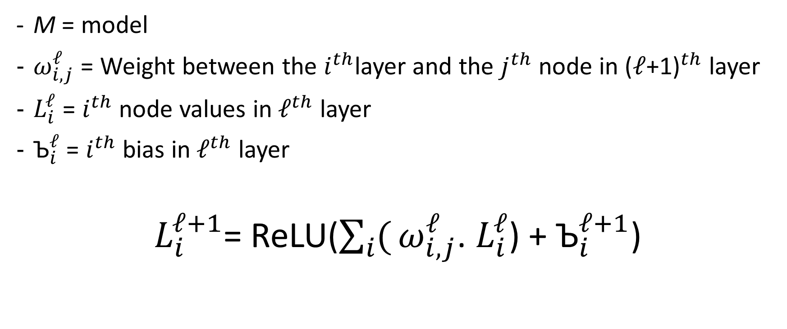
Framework
M = model
$ω_{i,j}^{ℓ}$ = Weight between the $i^{th}$layer and the $j^{th}$ node in ${\text{(}ℓ\text{+1)}}^{th}$ layer
$L_{i}^{ℓ}$ = $i^{th}$ node values in${ ℓ}^{th}$ layer
${\text{Ъ}}_{i}^{ℓ}$ = $i^{th}$ bias in${ ℓ}^{th}$ layer
$L_{i}^{ℓ+1}$= ReLU($\sum_{i}{(}ω_{i,j}^{ℓ}$. $L_{i}^{ℓ}$) + ${\text{Ъ}}_{i}^{ℓ+1}$)

Slide 9
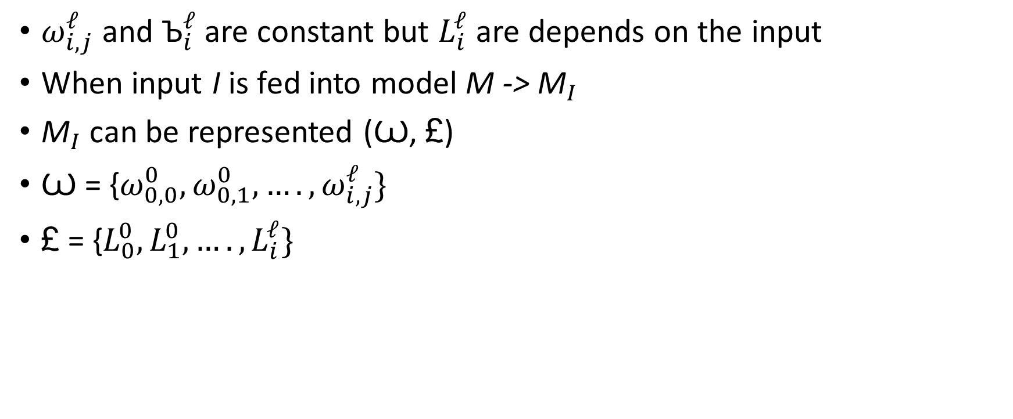
Trained Model
$ω_{i,j}^{ℓ}$ and ${\text{Ъ}}_{i}^{ℓ}$ are constant but $L_{i}^{ℓ}$ are depends on the input
When input I is fed into model M -> ${\text{M}}_{I}$
${\text{M}}_{I}$ can be represented (Ꙍ, £)
Ꙍ = {$ω_{0,0}^{0},ω_{0,1}^{0}, ….,ω_{i,j}^{ℓ}\}$
£ = {$L_{0}^{0},L_{1}^{0}, ….,L_{i}^{ℓ}\}$

Slide 10
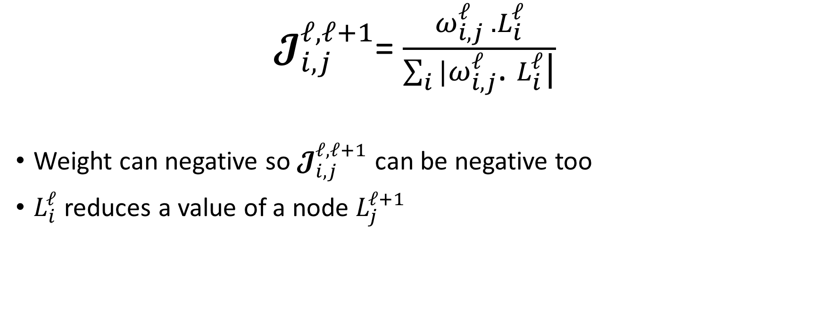
Influential Matrix
$𝓙_{i,j}^{ℓ,ℓ+1}$= $\frac{ω_{i,j}^{ℓ} .L_{i}^{ℓ}}{\sum_{i}{|}ω_{i,j}^{ℓ}\text{.} L_{i}^{ℓ}\text{|}}$
Weight can negative so $𝓙_{i,j}^{ℓ,ℓ+1}$ can be negative too
$L_{i}^{ℓ}$ reduces a value of a node $L_{j}^{ℓ+1}$

Slide 11
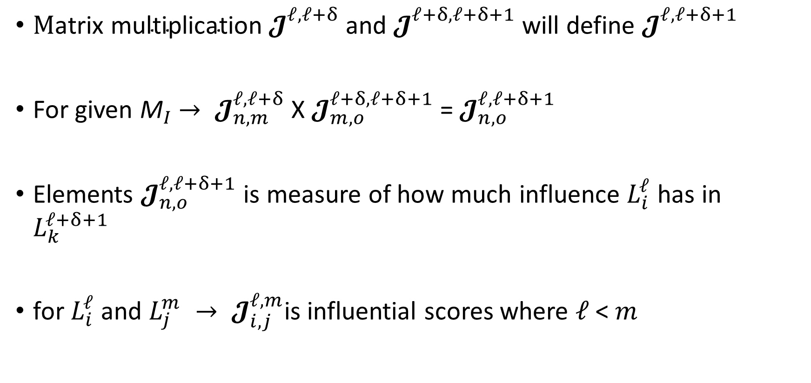
$\text{M}\text{atrix} \text{multiplication} 𝓙_{}^{ℓ,ℓ+δ}$ and $𝓙_{}^{ℓ+δ,ℓ+δ+1}$ will define $𝓙_{}^{ℓ,ℓ+δ+1}$
For given ${\text{M}}_{I}$ $→ 𝓙_{n,m}^{ℓ,ℓ+δ}$ X $𝓙_{m,o}^{ℓ+δ,ℓ+δ+1}$ = $𝓙_{n,o}^{ℓ,ℓ+δ+1}$
Elements $𝓙_{n,o}^{ℓ,ℓ+δ+1}$ is measure of how much influence $L_{i}^{ℓ}$ has in $L_{k}^{ℓ+δ+1}$
for $L_{i}^{ℓ}$ and $L_{j}^{m} → 𝓙_{i,j}^{ℓ,m}$is influential scores where $ℓ \text{<} m$

Slide 12
Usefulness of Influential Score
Normalized between -1 to 1
Two nodes have positively proportional, the influential score become 1 and otherwise
Node are complicatedly connected
Not easy to see how their influences
The influential scores show these connections
Simple matrix products

Slide 13

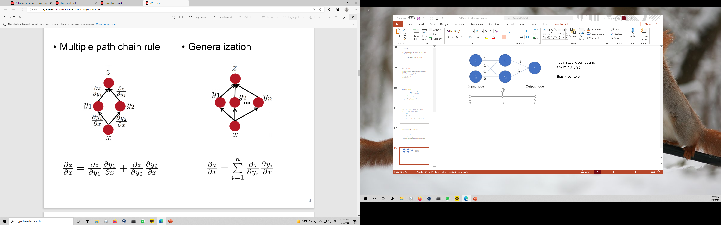
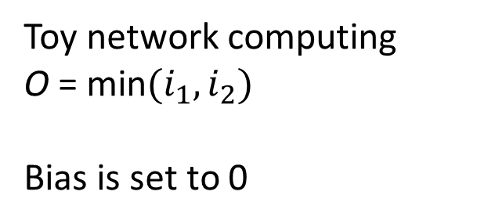
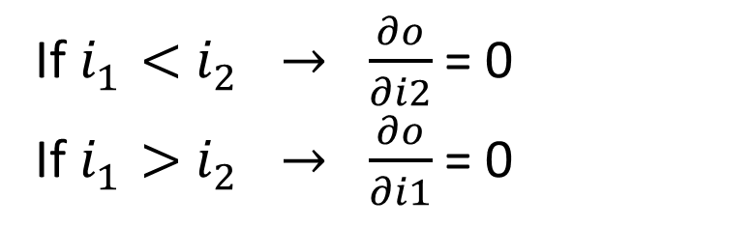
Toy network computing
O = min$(i_{1},i_{2})$
Bias is set to 0
If${ i}_{1}^{}<{ i}_{2}^{} → \frac{∂o}{∂i2}$ = 0
If${ i}_{1}^{}>{ i}_{2}^{} → \frac{∂o}{∂i1}$ = 0
notes

Slide 14
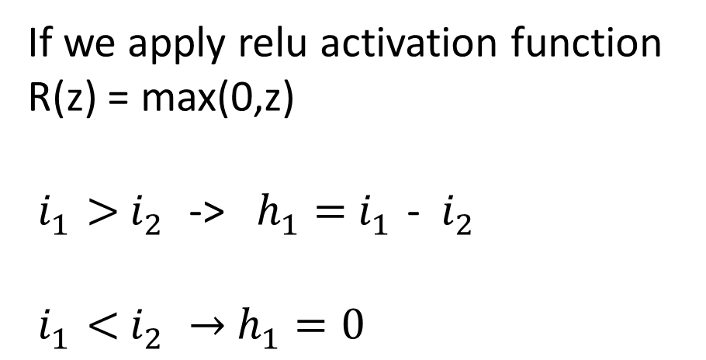
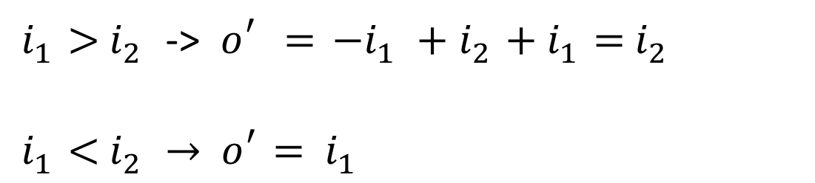
If we apply relu activation function
R(z) = max(0,z)
${ i}_{1}^{}>{ i}_{2}^{}$-> ${ h}_{1}^{}={ i}_{1}^{}$- ${ i}_{2}^{}$
$${ i}_{1}^{}<{ i}_{2}^{} →{ h}_{1}^{}=0$$
${ i}_{1}^{}>{ i}_{2}^{}$-> $o_{}^{′}={ −i}_{1}^{}+{ i}_{2}^{}+{ i}_{1}^{}={ i}_{2}^{}$
$${ i}_{1}^{}<{ i}_{2}^{} →{ o}_{}^{′}= { i}_{1}^{}$$

Slide 15
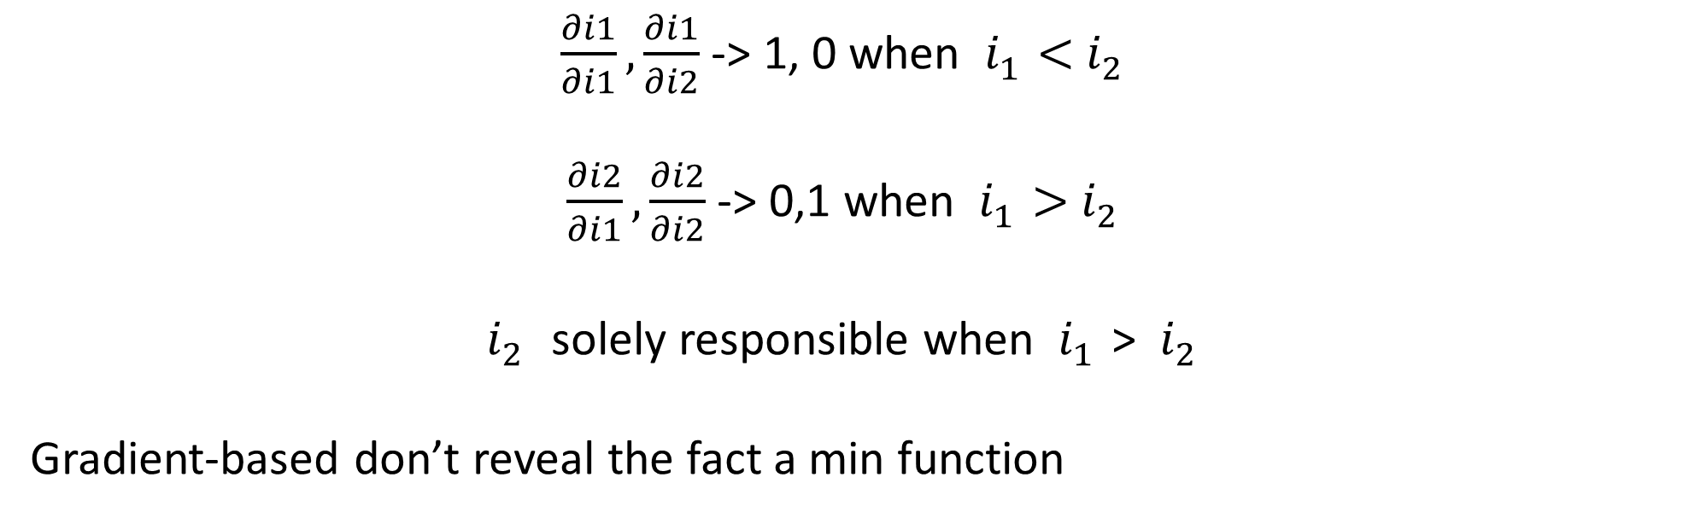
Using Saliency map and gradient input method from K. Simonyan (2013)
$\frac{∂i1}{∂i1},\frac{∂i1}{∂i2}$ -> 1, 0 when ${ i}_{1}^{}<{ i}_{2}^{}$
$\frac{∂i2}{∂i1},\frac{∂i2}{∂i2}$ -> 0,1 when ${ i}_{1}^{}>{ i}_{2}^{}$
$i_{2}^{}$ solely responsible when ${ i}_{1}^{}$> ${ i}_{2}^{}$
Gradient-based don’t reveal the fact a min function

Slide 16
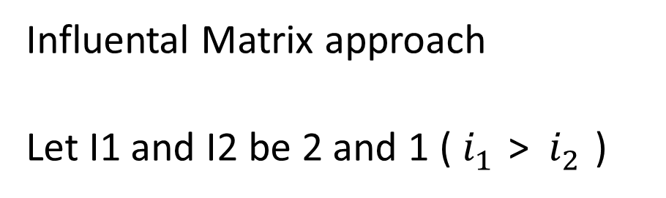
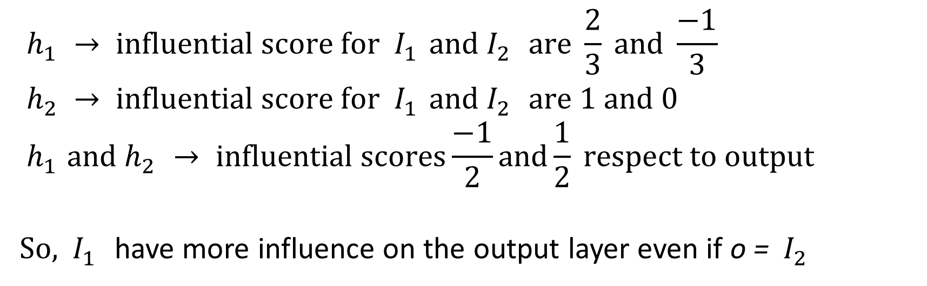
Influental Matrix approach
Let I1 and I2 be 2 and 1 (${ i}_{1}^{}$> ${ i}_{2}^{}$)
$${ h}_{1}^{} → influential score for { I}_{1}^{}and{ I}_{2}^{} are \frac{2}{3} and \frac{−1}{3}$$
$${ h}_{2}^{} → influential score for { I}_{1}^{}and{ I}_{2}^{} are 1 and 0$$
$${ h}_{1}^{}{and h}_{2}^{}→ influential scores\frac{−1}{2}and\frac{1}{2} respect to output$$
So, ${ I}_{1}^{}$ have more influence on the output layer even if o = ${ I}_{2}^{}$

Slide 17
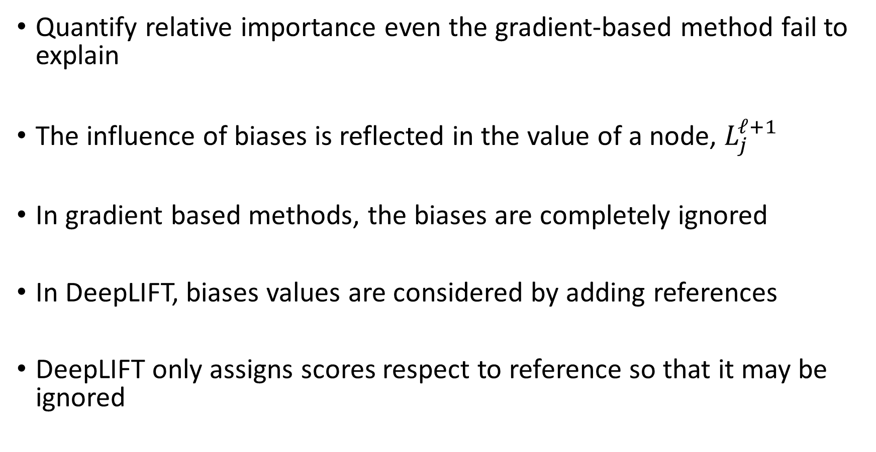
Quantify relative importance even the gradient-based method fail to explain
The influence of biases is reflected in the value of a node, $L_{j}^{ℓ+1}$
In gradient based methods, the biases are completely ignored
In DeepLIFT, biases values are considered by adding references
DeepLIFT only assigns scores respect to reference so that it may be ignored

Slide 18
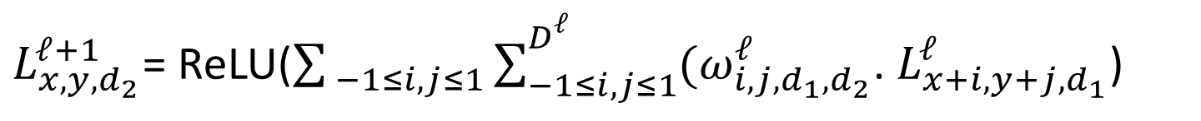
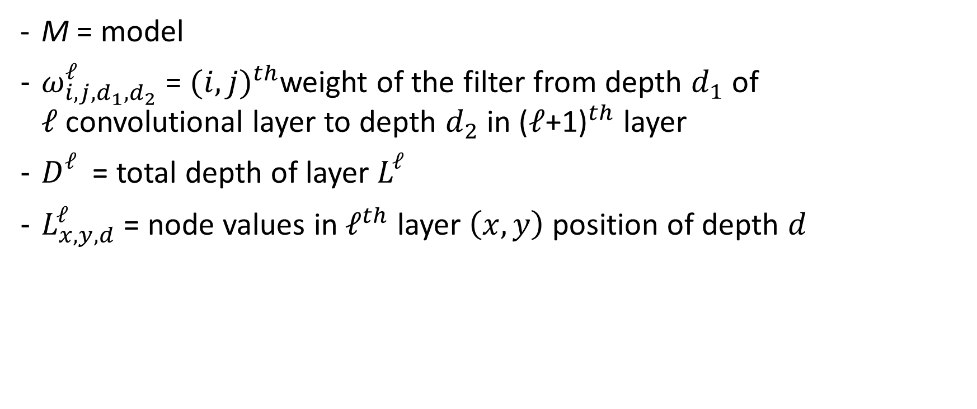
Influential Tensor for CNN
M = model
$ω_{i,j,d_{1}{,d}_{2}}^{ℓ}$ = ${(i,j)}^{th}$weight of the filter from depth $d_{1}$ of $ℓ$convolutional layer to depth $d_{2}$ in ${\text{(}ℓ\text{+1)}}^{th}$ layer
$D_{}^{ℓ}$ = total depth of layer $L_{}^{ℓ}$
$L_{x,y,d}^{ℓ}$ = node values in${ ℓ}^{th}$ layer $\left(x,y\right)$ position of depth $d$
$L_{x,y,d_{2}}^{ℓ+1}$= ReLU($\sum_{ −1≤i,j≤1}{\sum_{−1≤i,j≤1}^{D_{}^{ℓ}}{{(ω}_{i,j,d_{1}{,d}_{2}}^{ℓ}\text{.} L_{x+i,y+j,d_{1}}^{ℓ}\text{)}} }$

Slide 19
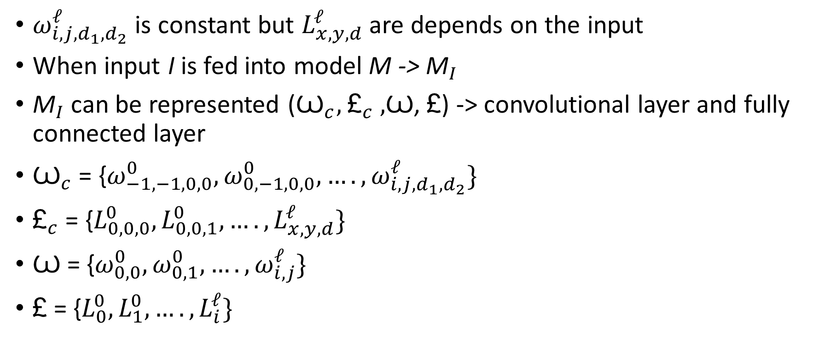
Trained Model
$ω_{i,j,d_{1}{,d}_{2}}^{ℓ}$ is constant but $L_{x,y,d}^{ℓ}$ are depends on the input
When input I is fed into model M -> ${\text{M}}_{I}$
${\text{M}}_{I}$ can be represented (${\text{Ꙍ}}_{c},$ ${\text{£}}_{c} ,$Ꙍ, £) -> convolutional layer and fully connected layer
${\text{Ꙍ}}_{c}$ = {$ω_{−1,−1,0,0}^{0},ω_{0,−1,0,0}^{0}, ….,ω_{i,j,d_{1}{,d}_{2}}^{ℓ}\}$
${\text{£}}_{c}$ = {$L_{0,0,0}^{0},L_{0,0,1}^{0}, ….,L_{x,y,d}^{ℓ}\}$
Ꙍ = {$ω_{0,0}^{0},ω_{0,1}^{0}, ….,ω_{i,j}^{ℓ}\}$
£ = {$L_{0}^{0},L_{1}^{0}, ….,L_{i}^{ℓ}\}$

Slide 20
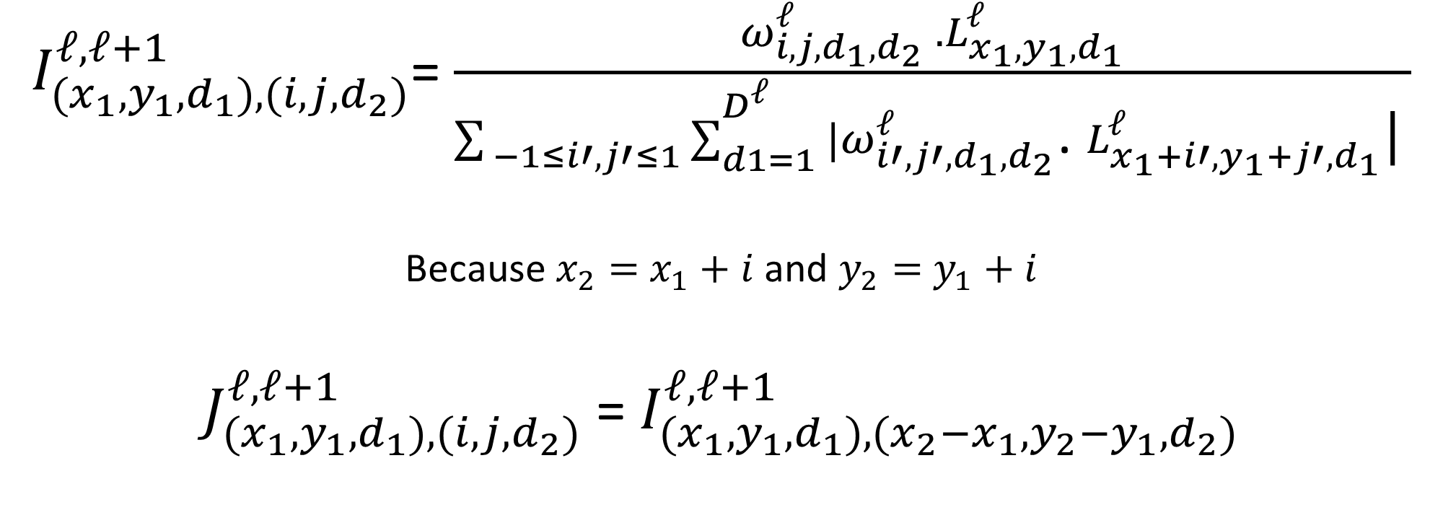
Influential Tensor
$I_{{(x}_{1},y_{1},d_{1}),(i,j,d_{2})}^{ℓ,ℓ+1}$= $\frac{ω_{i,j,d_{1},d_{2}}^{ℓ} .L_{x_{1},y_{1},d_{1}}^{ℓ}}{\sum_{ −1≤i′,j′≤1}{\sum_{d1=1}^{D_{}^{ℓ}}{{|ω}_{i′,j′,d_{1}{,d}_{2}}^{ℓ}\text{.} L_{x_{1}+i′,y_{1}+j′,d_{1}}^{ℓ}\text{|}} }}$
Because $x_{2}=$ $x_{1}+i$ and $y_{2}=$ $y_{1}+i$
$J_{{(x}_{1},y_{1},d_{1}),(i,j,d_{2})}^{ℓ,ℓ+1}$ = $I_{{(x}_{1},y_{1},d_{1}),(x_{2}−x_{1},y_{2}−y_{1},d_{2})}^{ℓ,ℓ+1}$

Slide 21
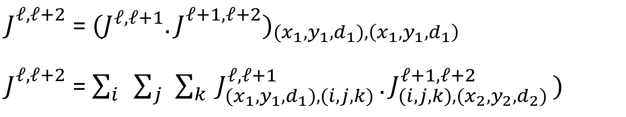
Influential Tensor Multiplication
$J_{}^{ℓ,ℓ+2}$ = ${{(J}^{ℓ,ℓ+1}.J_{}^{ℓ+1,ℓ+2})}_{\begin{aligned}{(x}_{1},y_{1},d_{1}),\left(x_{1},y_{1},d_{1}\right) \\ \end{aligned}}$
$J_{}^{ℓ,ℓ+2}$ = $\sum_{i}{\sum_{j}{\sum_{k}{J_{{(x}_{1},y_{1},d_{1}),(i,j,k) }^{ℓ,ℓ+1}.J_{(i,j,k),(x_{2},y_{2},d_{2}) }^{ℓ+1,ℓ+2})}}}$

Slide 22
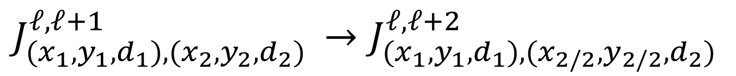
Max-pooling
selects the maximum value among the filtered results in a sub-region
$$J_{{(x}_{1},y_{1},d_{1}),(x_{2},y_{2},d_{2}) }^{ℓ,ℓ+1}→J_{{(x}_{1},y_{1},d_{1}),(x_{2/2},y_{2/2},d_{2}) }^{ℓ,ℓ+2}$$

Slide 23
Experiment

Slide 24
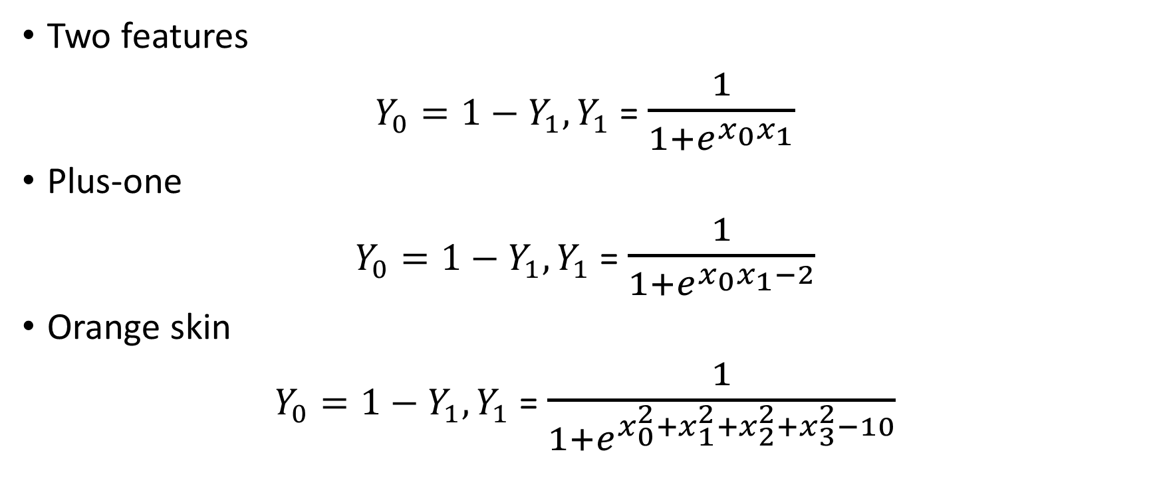
Synthetic Data (10D random input Xs)
Two features
$Y_{0}=1−Y_{1}, Y_{1}$ = $\frac{1}{{1+e}^{x_{0}x_{1}}}$
Plus-one
$Y_{0}=1−Y_{1}, Y_{1}$ = $\frac{1}{{1+e}^{x_{0}x_{1}−2}}$
Orange skin
$Y_{0}=1−Y_{1}, Y_{1}$ = $\frac{1}{{1+e}^{x_{0}^{2}{+x}_{1}^{2}+x_{2}^{2}+x_{3}^{2}−10}}$

Slide 25
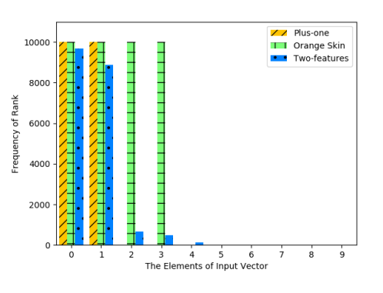
The rest element of X don’t have any effect
Can pick relevant inputs that have effects on the output
Ranks : how many times elements get large influential scores

Slide 26
Local and global feature selection
Selecting a subset of features
Improving the prediction
Entire labeled samples, i.e., feature selection is “globally” informative.
Influential scores only inform the specific input
So, it’s called “local” information

Slide 27
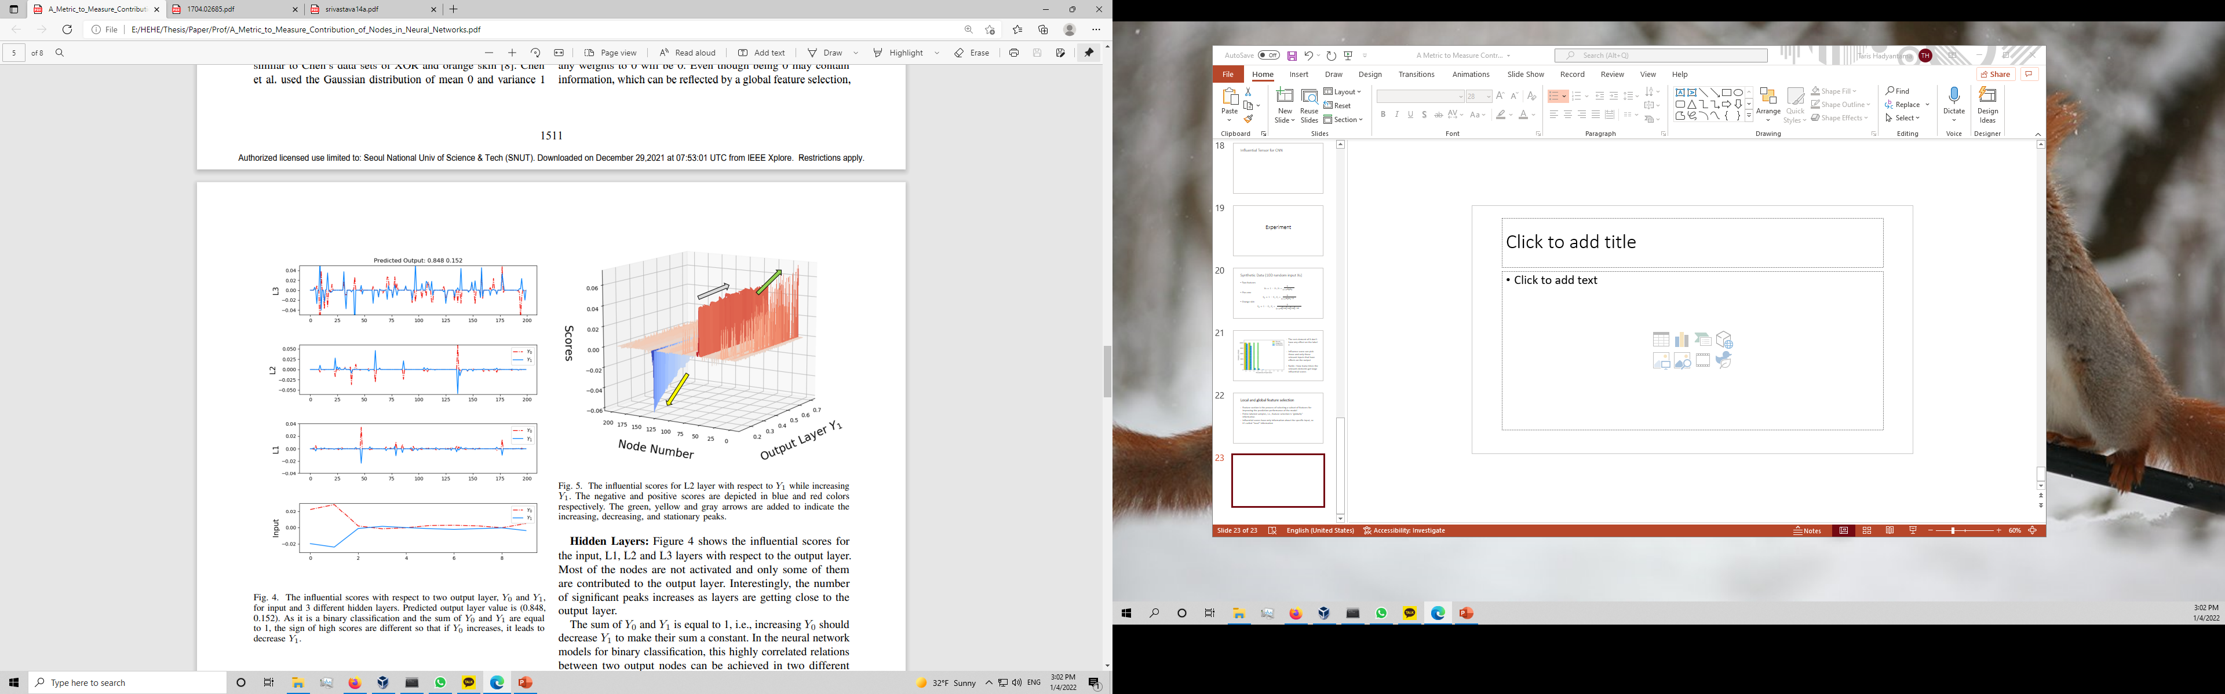
Some elements of an input have 0 or very close to it
The influential scores select features locally
Show the intrinsic characteristics
The negative values imply to degrade the output layer value

Slide 28
This is scores for L2 while increasing Y1
Most of the nodes are not activated
Only some of them are contributed

Slide 29
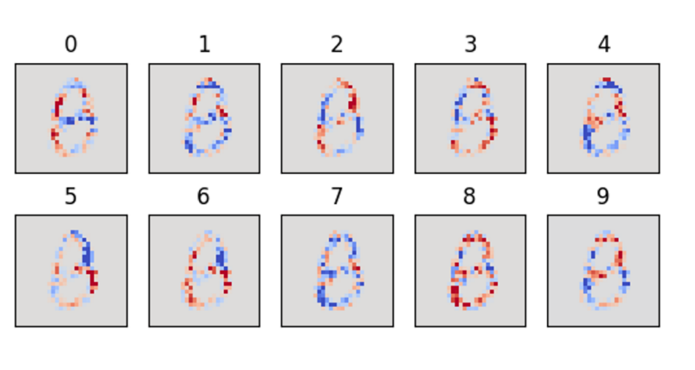
MNIST Digits

Slide 30
Generated by Jung
Hybrid Neural Network
Using CNN and 41 general image kernels
Using 64 3x3 and 128 3x3 filter in each convolutional layers
Using 2x2 max pooling after convolutional layers
The first and second dense layer are 2048x625 and 625x10

Slide 31
The Influential score images for number eight
Red pixels -> positive scores
Blue pixels -> negative scores
Informative pixels shown by red pixels
Blue pixels show why the network doesn’t classify the image as 8

Slide 32
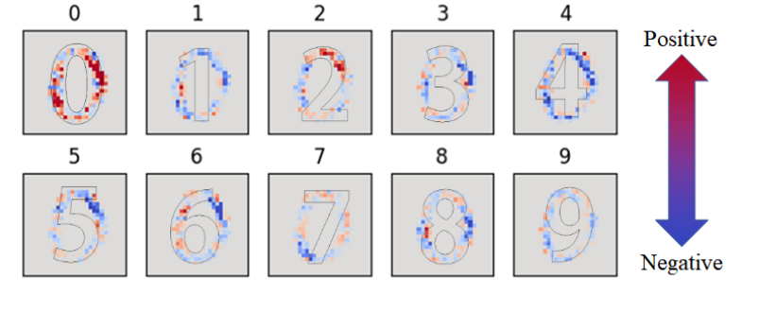
Positive score contribute to classifying the input image to the “0”
Red dots -> classified as the number zero
Red dots only overlaid regions between an input digit image and number outline

Slide 33
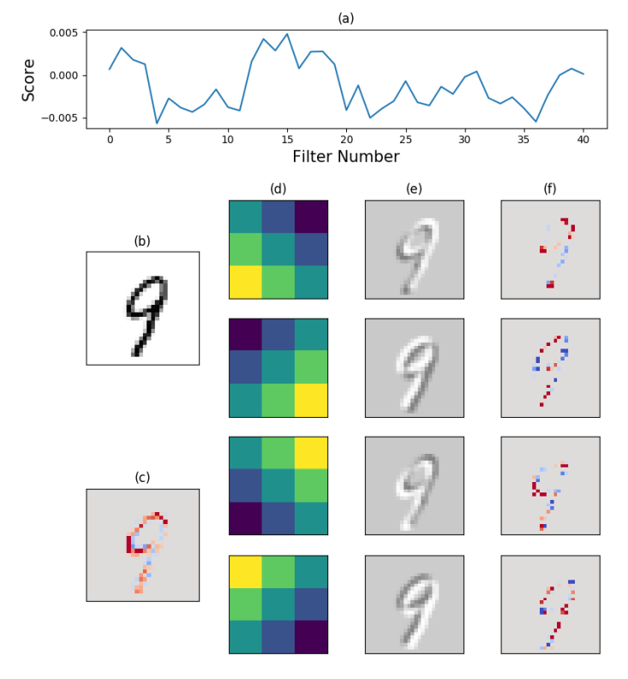
Influential scores for 41 different filters to “9”
Image (b) original image (c) influential score respect to “9”
(d) schematic image of 7th 15th and 23rd filter
(e) Convoluted onto the original image
(f) influential scores for each filter to “9”

Slide 34
Filters are more important than the others
We can call it filter scores
Indicate how important these filters are in the classification of a specific input image

Slide 35
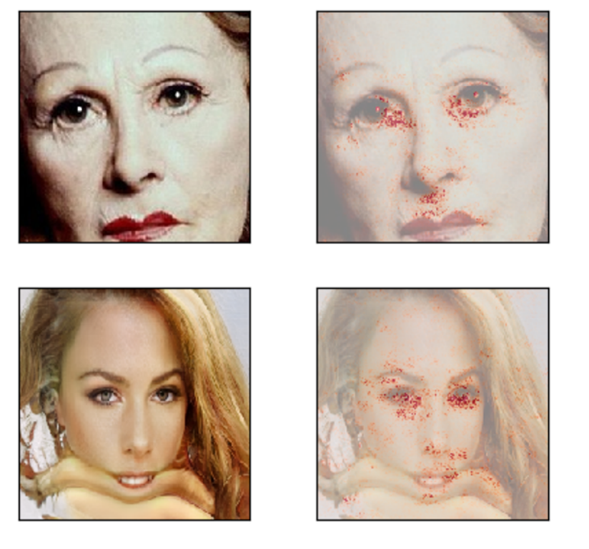
GAN-Generated Fake Image Detection

Slide 36
GAN generated 114000 fake face and 73877 real face images
Input dimension 224x224x3
CNN with max-pooling layer
32 3x3 filters, 64 3x3 filters and 128 3x3 filters
Used 3x3 max-pooling and 2x2 max-pooling for the last layer
The dense layer has 625x2 dimensions

Slide 37
Successfully detect fake image from real ones
Don’t explain how the model can discriminate fake images
Influential scores in the model can discriminate fake images

Slide 38
Upper images are real, and bottom are fake
Important position for the classification generated by the influential scores
Fake image has no jaw, but the network model does not recognize

Slide 39
Conclusion this paper
Influential scores are an indicator of which features are crucial for a prediction
Influential score provide both supporting and opposing reasons for the prediction
Influential scores knowing how each instance behaves
Unnecessary nodes and weights can possibly be eliminated
Systemic initialization of the NN might be achievable

Slide 40
Design a dropout strategy using the result of the paper

Slide 41
What is Dropout??
“Dropout: A Simple Way to Prevent Neural network from Overfitting”
Nitish Srivastava, Geoffrey Hinton (2014)
Dropout is randomly drop units (along with their connections) from the neural network during training

Slide 42
Overfitting
A model learns the detail and noise in the training data
Negatively impacts the performance of the model on new data.
Noise or random fluctuations in the training data is picked up and learned
These concepts do not apply to new data
Negatively impact the model’s ability to generalize.

Slide 43
Why use Dropout?
Overfitting is a serious problem in such network
Large networks difficult to deal with overfitting
Dropout is a technique for addressing this problem
This prevents units from co-adapting too much

Slide 44
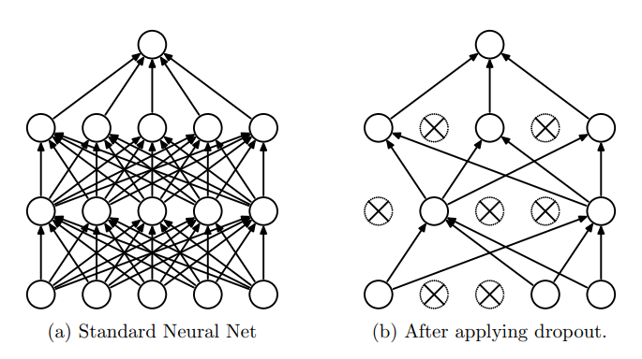

Slide 45
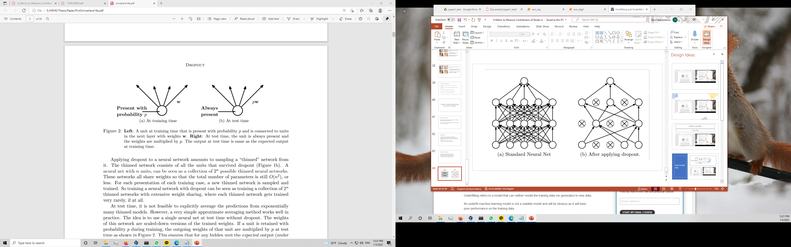
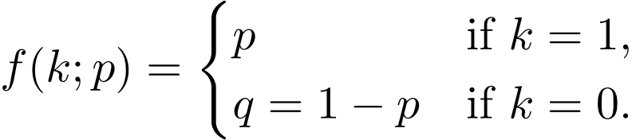
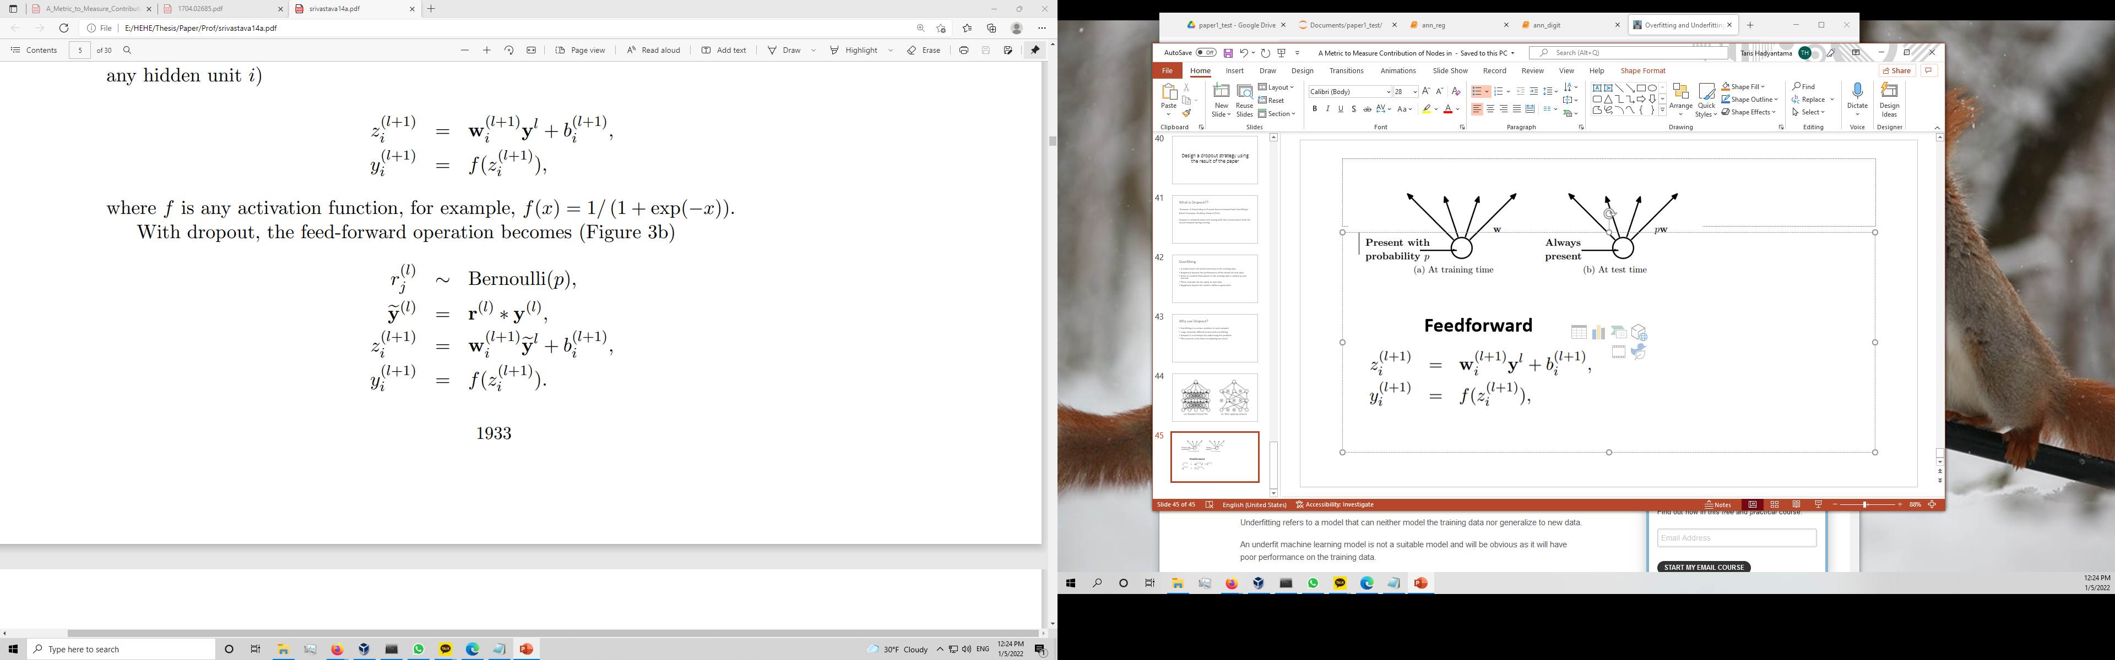

Feedforward

Slide 46
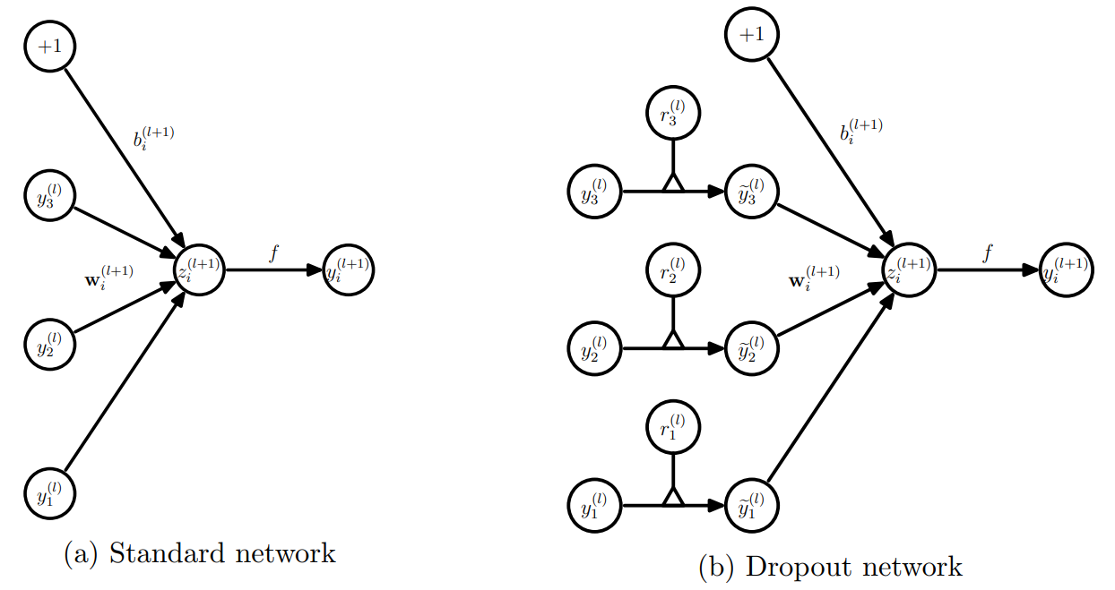
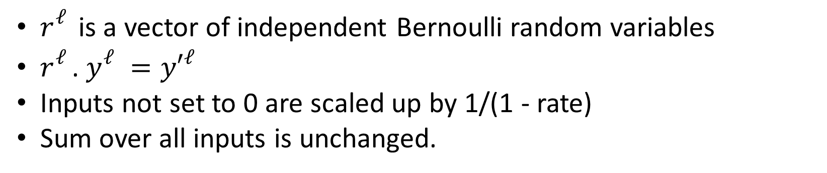
$r_{}^{ℓ}$is a vector of independent Bernoulli random variables
$r_{}^{ℓ}$. $y_{}^{ℓ}={y′}_{}^{ℓ}$
Inputs not set to 0 are scaled up by 1/(1 - rate)
Sum over all inputs is unchanged.

Slide 47
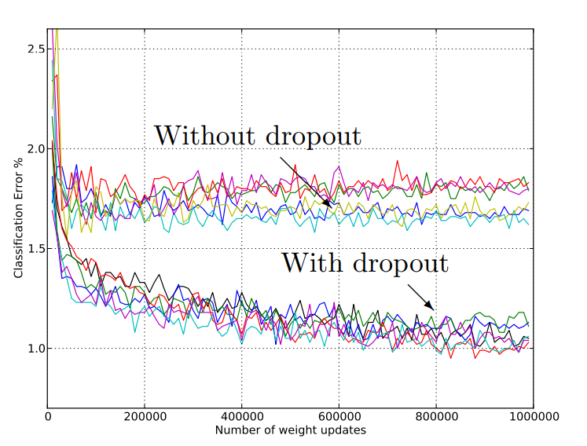

Slide 48
Problem with Dropout
Random dropout using Bernoulli random variables
Unnatural set for rate
Want to drop only node that co-adapting too much
Sometimes drop crucial node

Slide 49
How Influential Matrix improve Dropout?
Can dropout node according influential score not random
Only drop less contribute node
Not drop crucial node
Prevent node co-adapting too much
does not damage the fitting performance
Can make specific dropout node number in each layer

Slide 50
Experiment 1
12 input
3 output
Dense 5 layer 128 nodes
9000 training data
700 test data

Slide 51
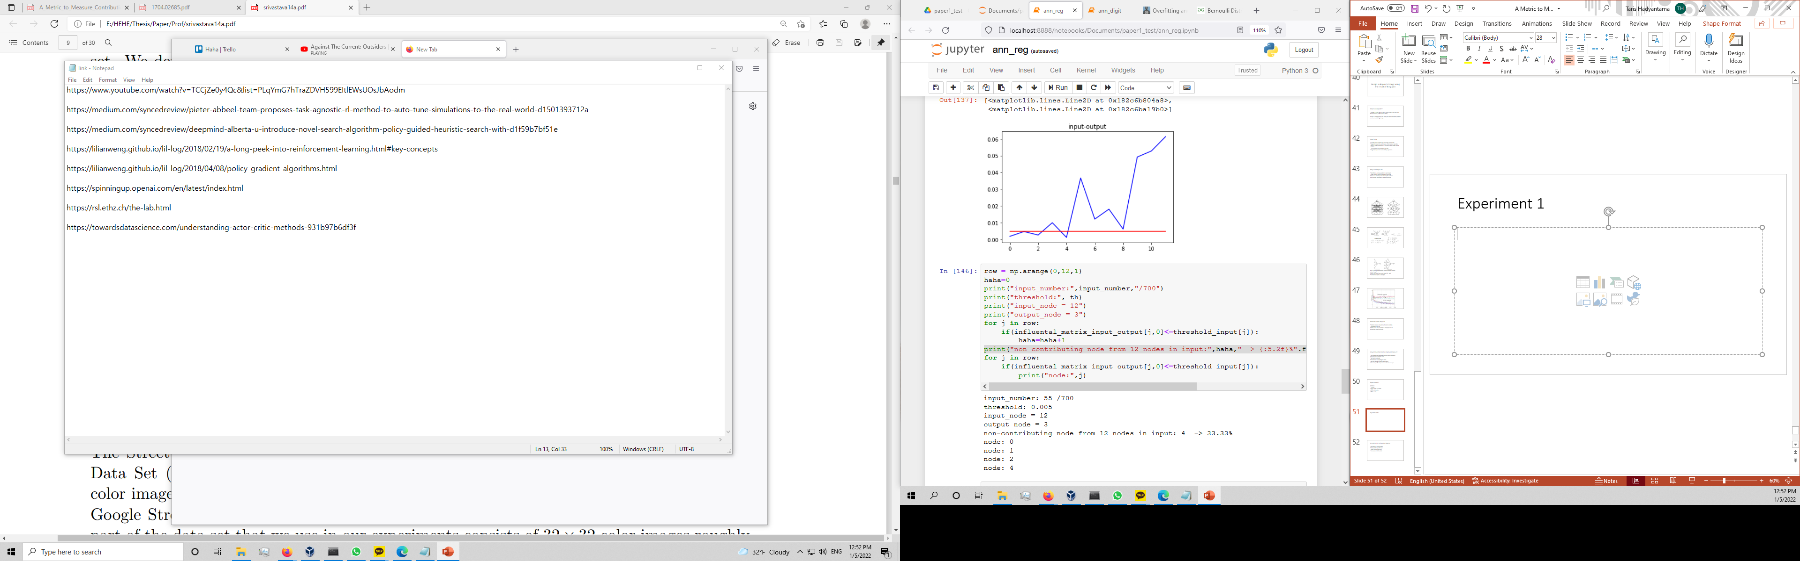
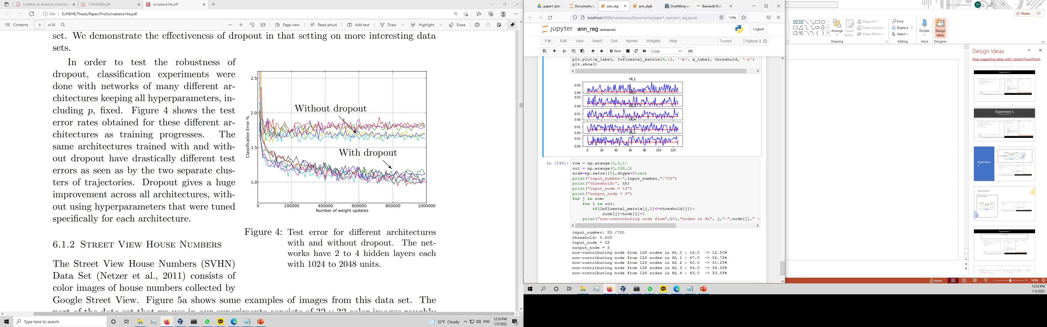
Experiment 1

Slide 52
Experiment 2
Digits classification MNIST
Input Flat 28x28
5 Hidden Layer 128 nodes
10 output

Slide 53
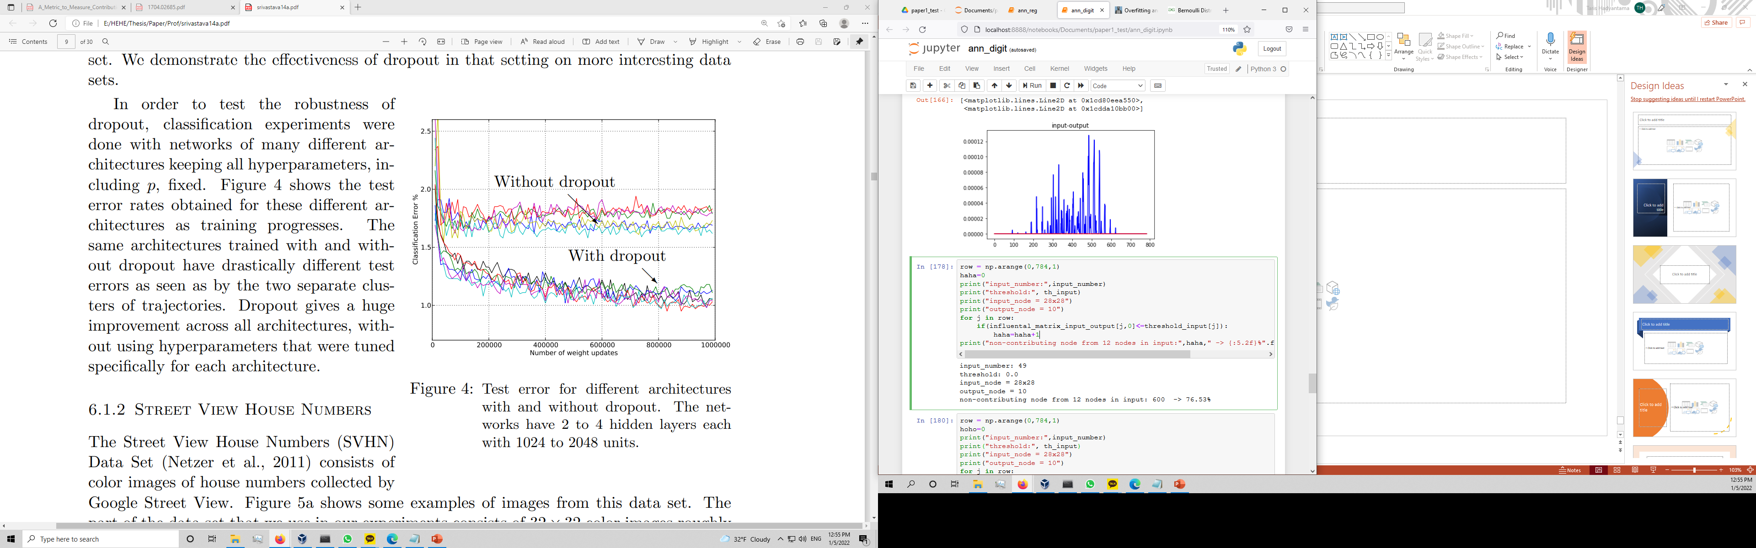

Experiment 2

Slide 54
Limitation in Influential Matrix
Only work on trained model
Only work for specific input
Locally featured selection
Unnatural set of threshold
Different input range, different threshold (DeepLift problem)
Doesn’t know how to determine non-contributed node

